Slide 1
Agile Data Preparation
Dec 2020

Slide 2

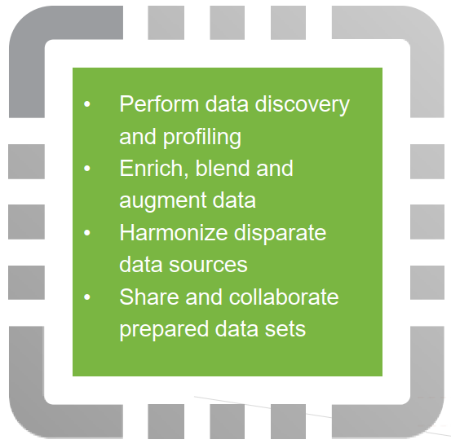
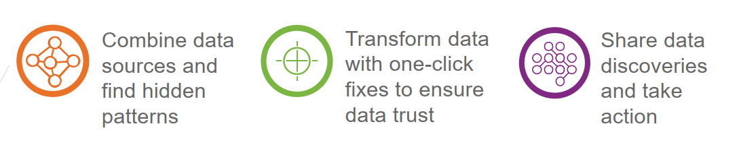
Introduction
Agile Data Preparation is a self service data preparation application that helps multiple user roles explore, integrate and transform raw data into actionable information

Slide 3

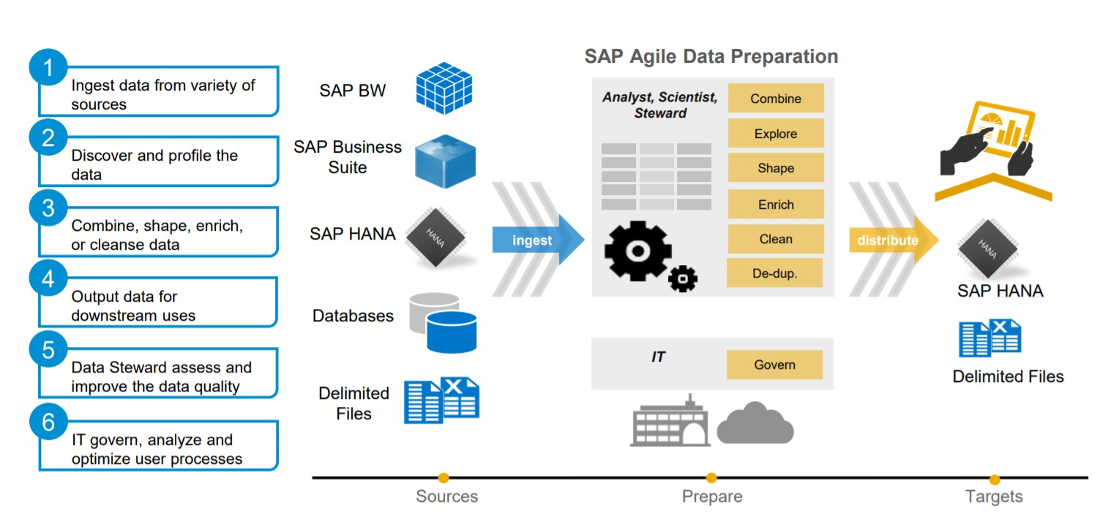
Key Capabilities

Slide 4
Comparison Agile Data preparation Vs Information Steward
Agile Data Preparation
Information Steward
Self service data preparation
Implementation and Transformation takes less time
Automatic cleansing and deduplication of data
May not require technical scripting skills
No self service data preparation
Implementation and Transformation takes comparatively more time
No automatic cleansing and deduplication of data
Requires technical scripting skills

Slide 5
Features
Automatic cleansing and deduplication of data
Operationalized data sets through an end to end self-service data
Export prepared data sets to analytical tools like SAP Analytics and BI solutions
Perform data discovery and profiling
Acquire data from remote sources that HANA SDI can access including NoSQL databases
Performs centralized data storage, monitoring, and constant refreshes and synchronization of global data
Shorter time for data preparation

Slide 6
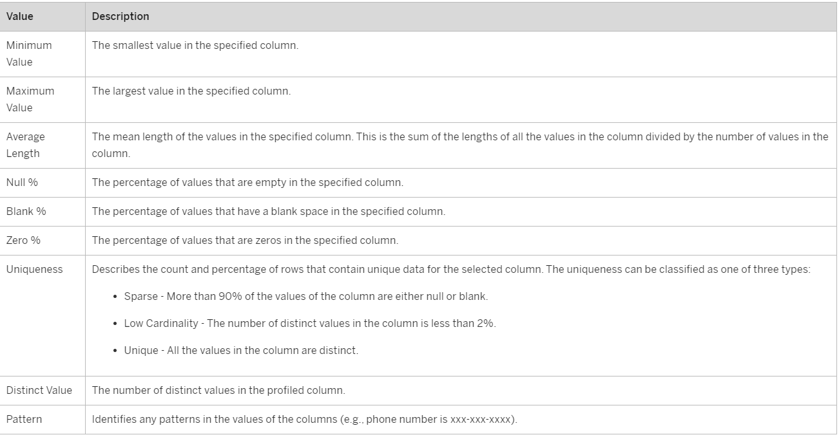
Basic Profiling – Data Quality Assessment
Data Quality Assessment will provide the following values in the result

Slide 7
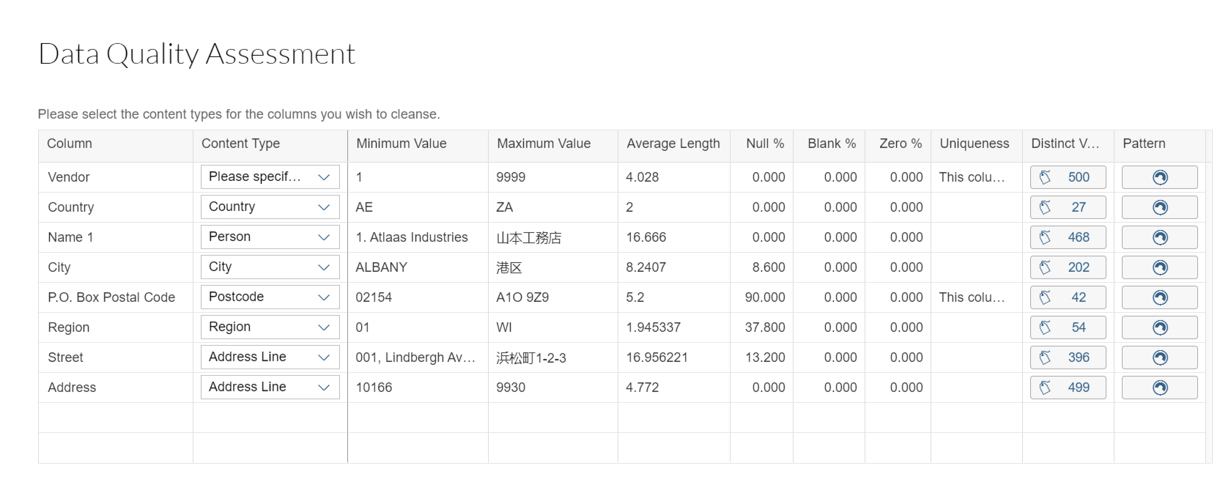
Basic Profiling – Results Example

Slide 8
Basic Profiling – Content type
Manual Profiling - ‘Assess Quality’ option under Actions in the right panel.
Automatic Profiling - ‘Enable Profiling’ while creating new worksheet.
In manual profiling, the content type should be manually chosen for each and every field whereas in automatic profiling, it would automatically chose the content type based on the content of the column.
It would chose the content type for the columns which are having proper values(e.g., country, region, postal code, Person or Firm name ) and it will be displayed along with profiling results.
If content type is specified, only those columns can be considered for cleansing.
Profiling results cannot be exported.

Slide 9
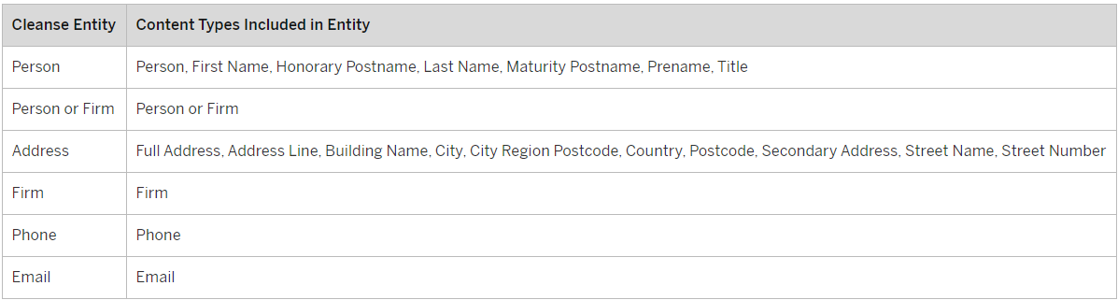
Data Cleansing - Introduction
Validate, correct, Standardize and format data
Works on group of columns called entities.
Entities are group of content types as shown below

Slide 10
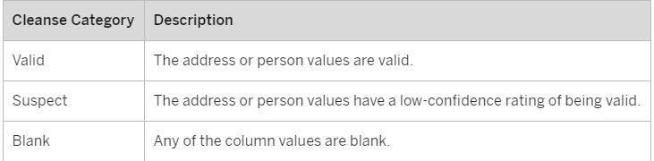
Data Cleansing – Data Quality Statistics
Cleansed outputs can be changed by selecting /deselecting entities.
Data quality statistics will have two graphs.
Cleanse summary
Cleanse significant changes
Cleanse summary graph.
Cleanse significant changes will provide number of records with significant changes per entity (Adding 4-digit suffix to postcodes, Correcting or filling in blank, postcodes and regions, Filling in blank city, Standardizing country name).

Slide 11
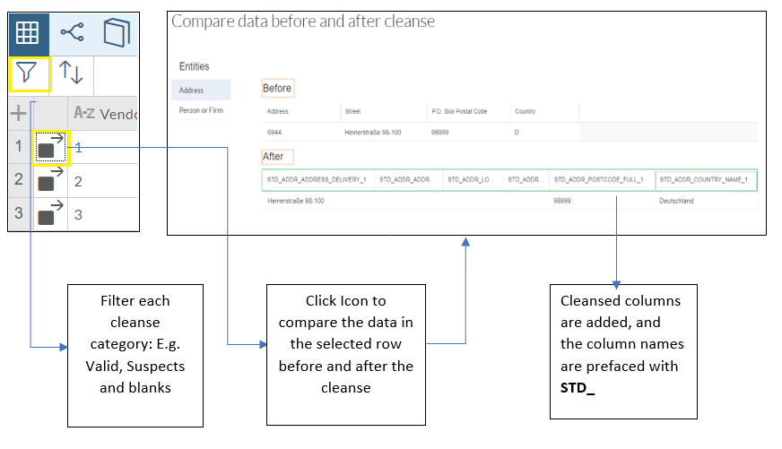
Data Cleansing – Worksheet Results

Slide 12
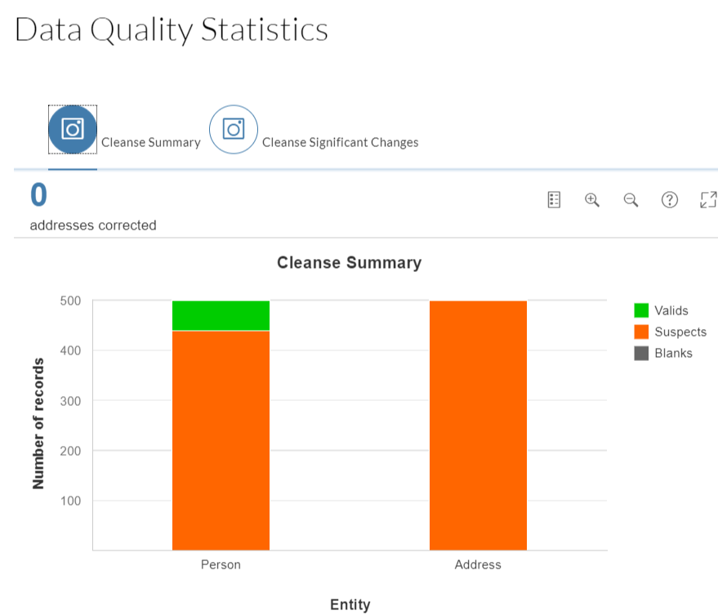
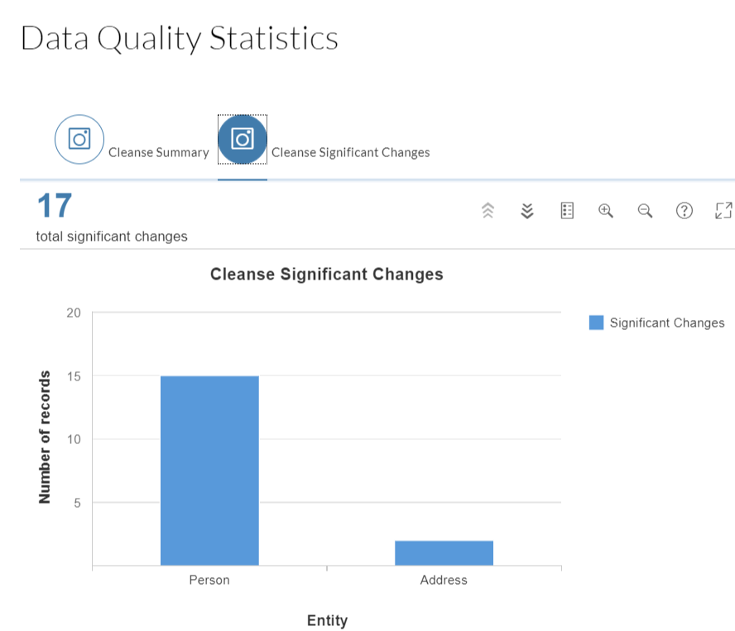
Data Cleansing – Results summary graph Example

Slide 13
Removing Duplicates - Introduction
Improves the quality of data by identifying and removing duplicate data records.
Process Involves below actions
Select match policies (Matching columns to identify duplicate records)
Select survival rule (Length, Most recent, Priority of sources)
Set strictness rule (How closely records need to match in order to considered duplicates)

Slide 14
Removing Duplicates – Export
We can export the duplicate records to one of the following targets
Excel (.xslx) file
SAP HANA table
Comma-separated values (.csv) file
Exported duplicate records will have following details
Group Id (Records that reside in the same match group will have same group Id)
Group Master (Group Id indicates all the records in a group whereas Group Master indicates which record within that group is a survivor based on selected survival rule)
Low confidence (Indicates whether the group is flagged for review. A match group is flagged for review when it contains one or more matching record pairs

Slide 15
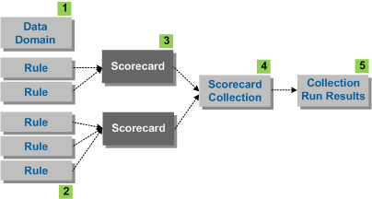
Scorecard
A data domain is a specific business area, which has specific data quality objectives that you can measure with scorecards.
A scorecard is comprised of one or more rules for which you want to obtain an average data quality score. For example, you can define a scorecard for each quality dimension, such as completeness, conformity, to obtain an average score in that quality dimension.

Slide 16
Scorecard Features
A scorecard set runs one or more scorecards to obtain an average data quality score, and you can drilldown into the results of each scorecard and each rule.
We can share scorecard set results and share it with other users who can click on the link to display and drill-down through the interactive charts.
We can exclude records from the list of records that failed in a scorecard set run to obtain a different quality score.
We can create a scorecard dashboard to share a scorecard with specific users or user groups and specify sharing conditions.
Data domain administrators can compare the data quality score of different rule, quality dimension, or drill-down column values in a single trend graph.

Slide 17
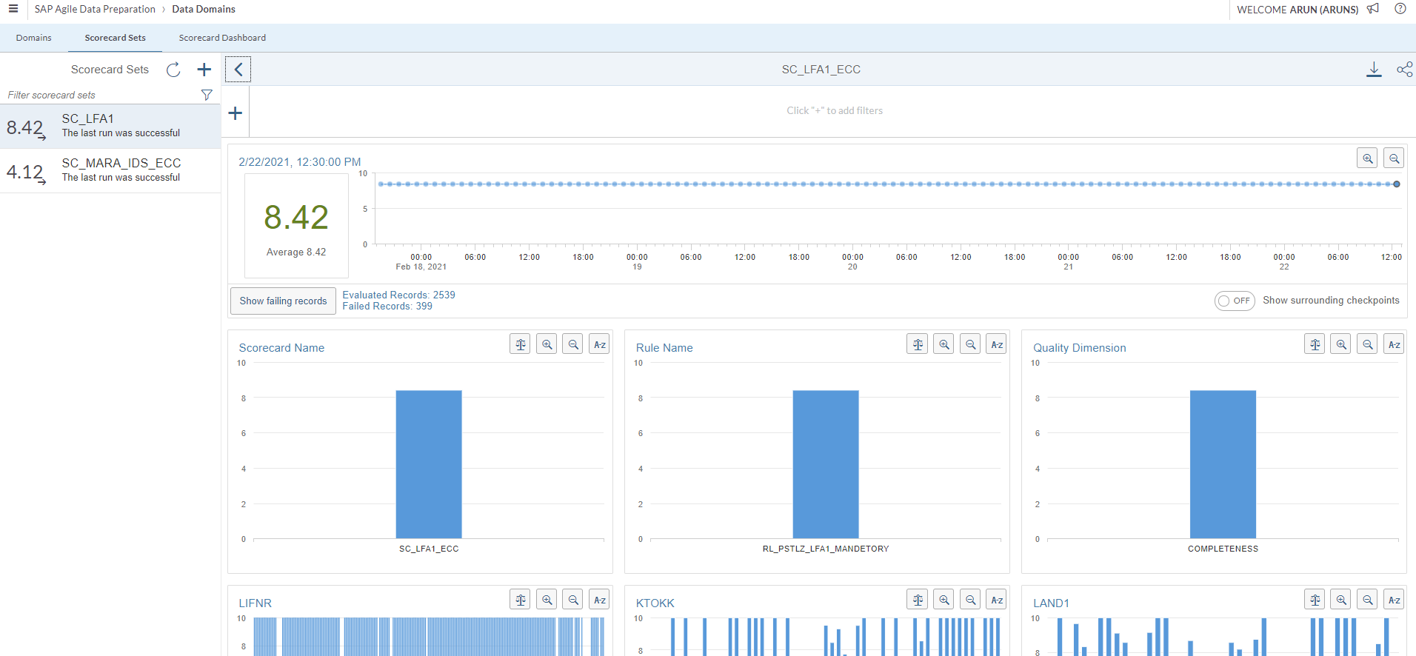
Scorecard set

Slide 18
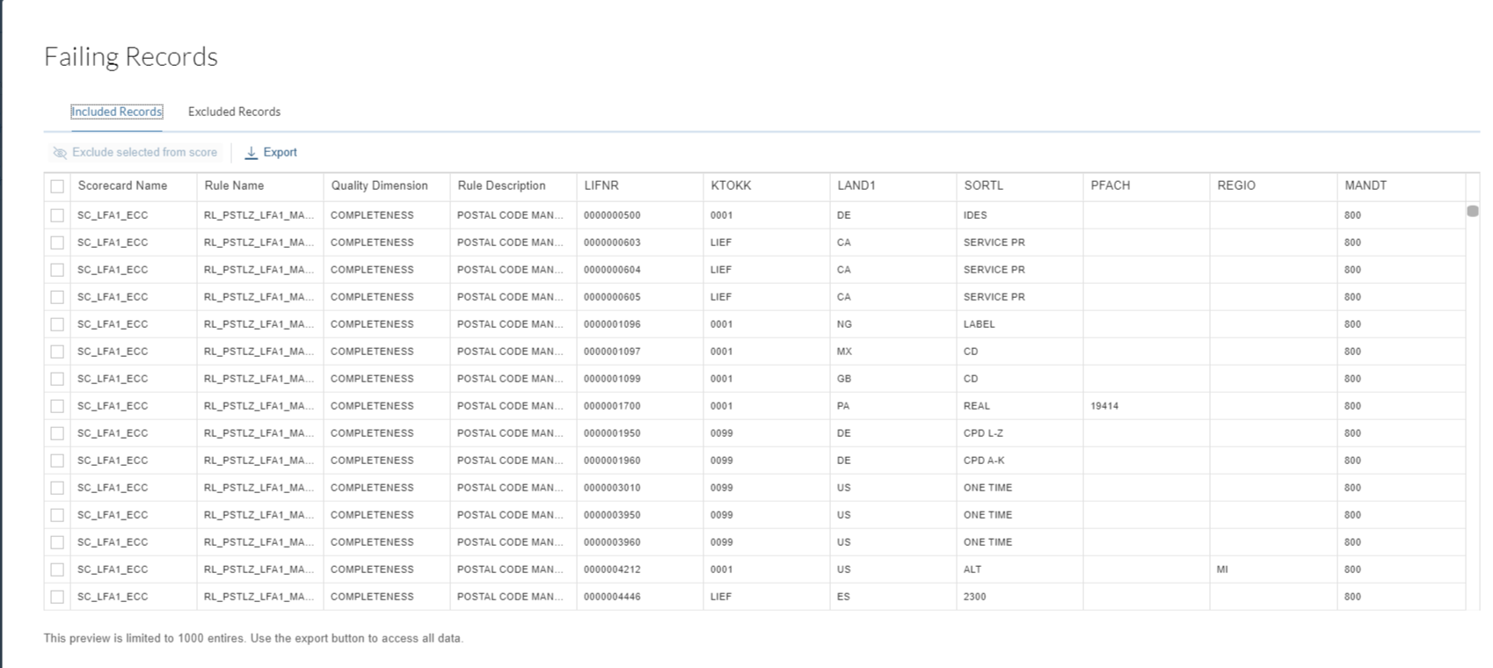
Scorecard – Failing records

Slide 19
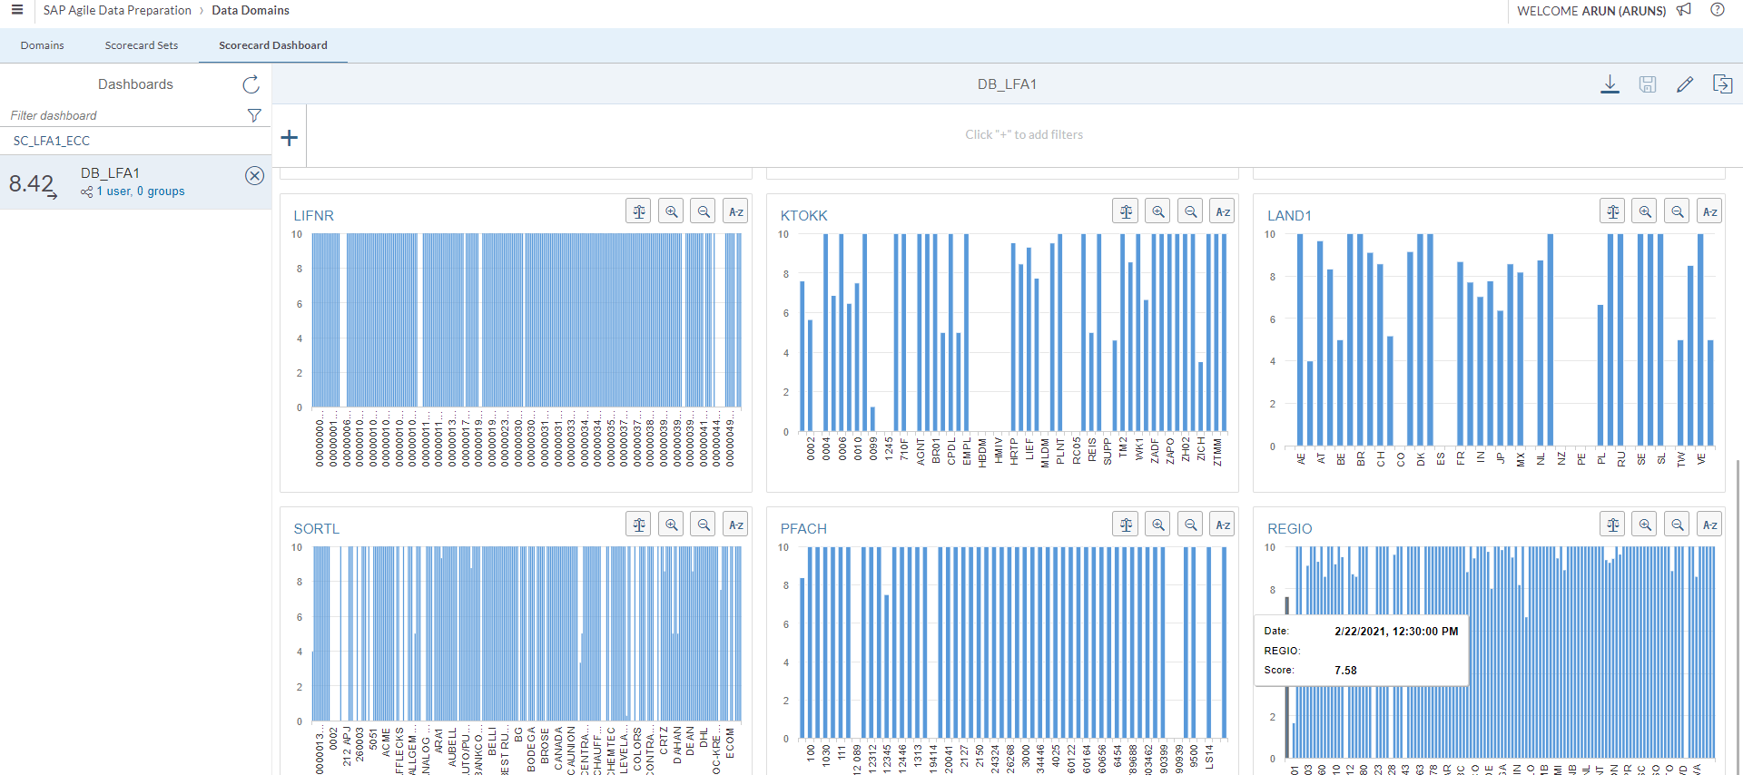
Scorecard – Dashboard

Slide 20
Scorecard - Scheduling
Created scorecard can be schedule the execution of a set of related scorecards to obtain a data quality score.
We should specify frequency, like hour, day, week, year, how often you want to run this scorecard.
We can export a scorecard or dashboard to a PDF.

